Slide 1
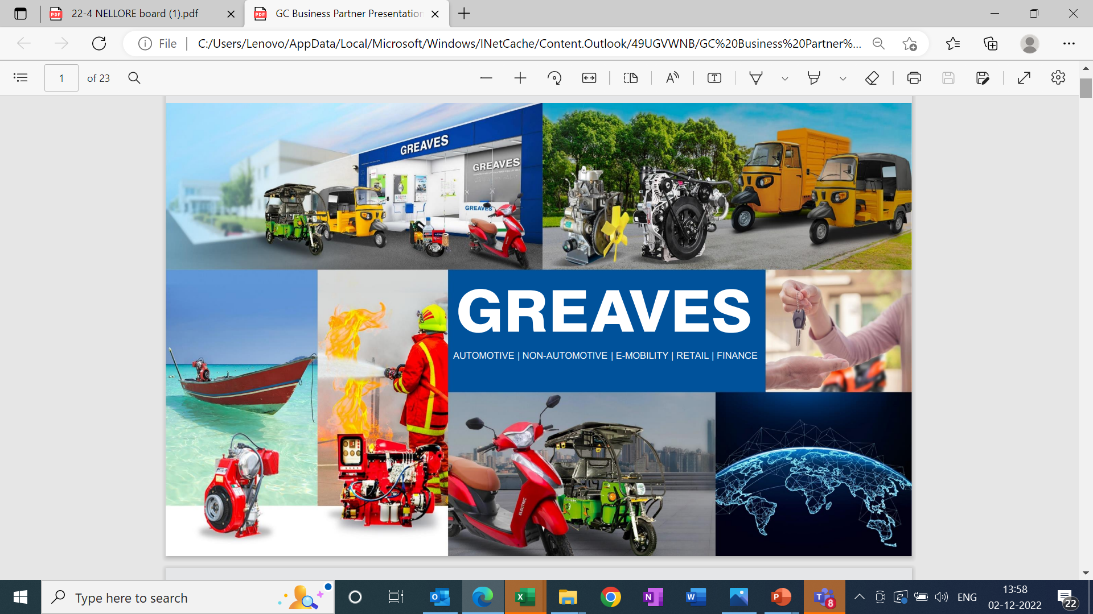

Slide 2
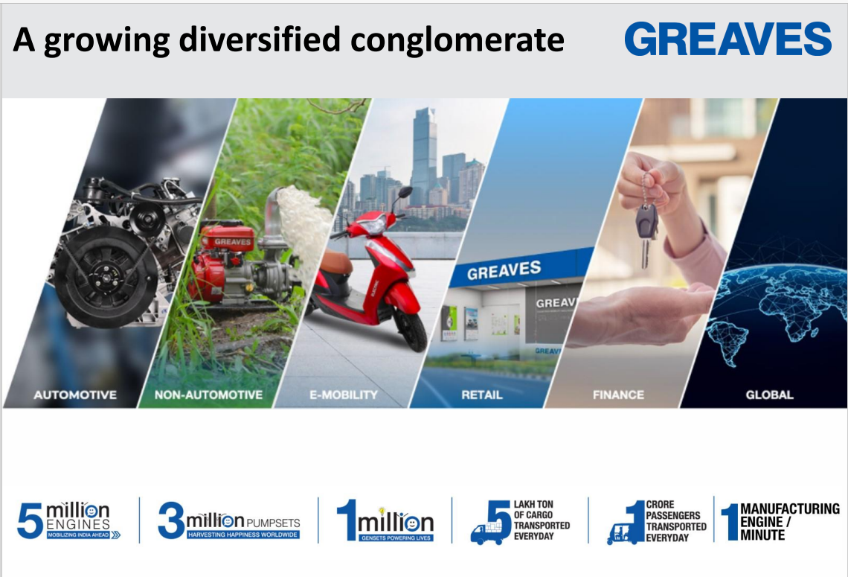

Slide 3
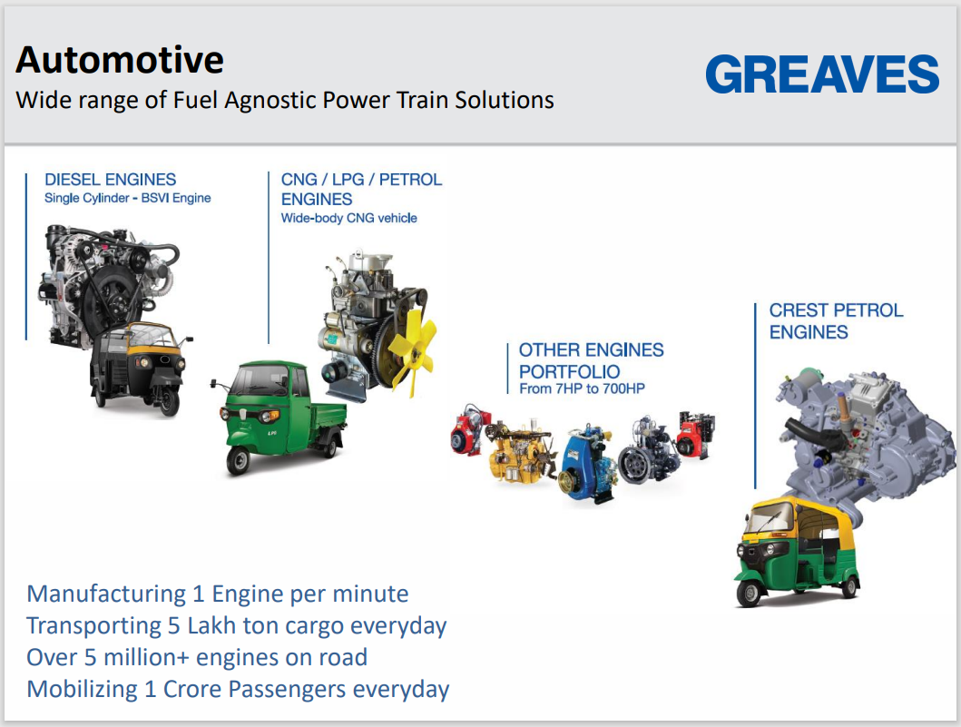

Slide 4

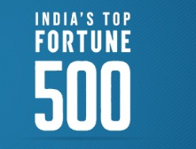
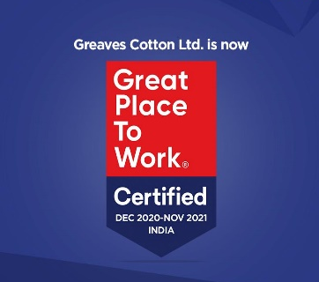
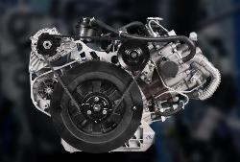
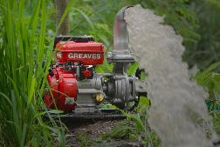
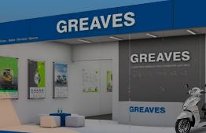
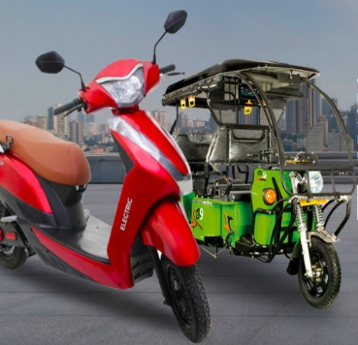
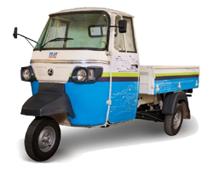
Greaves- a Diversified Engineering Company
Driven by passion, guided by Technovation
Multi-product multi-location company with a rich legacy and brand trust of over 162 years
Greaves Cotton is a leading name in the domain of Engines, Retail, Electric Mobility, Finance and Technology services
Through its diversified product portfolio, directly and indirectly Greaves impacts more than a billion live everyday
A manufacturer of world-class products and sustainable solutions under various business units
ENGINES
RETAIL
ELECTRIC MOBILITY

Slide 5
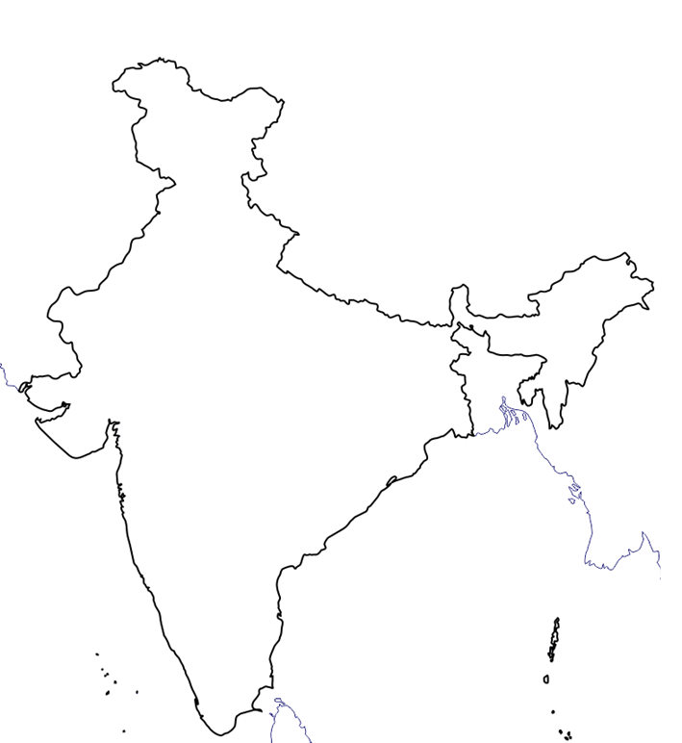
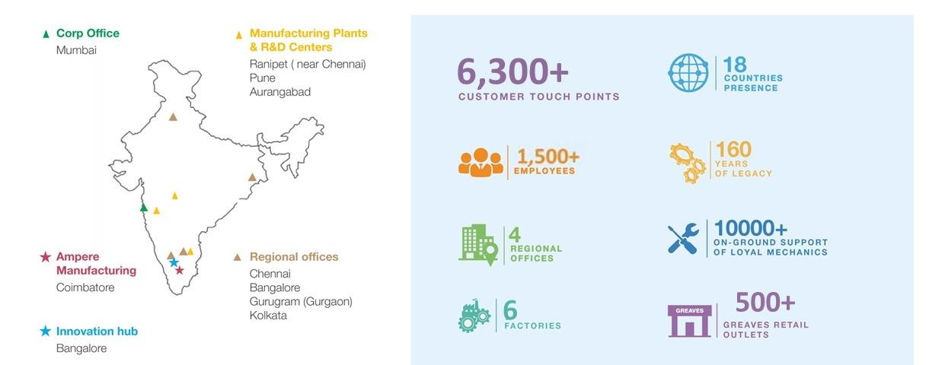
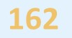
Greaves- an unparalleled reach in India
7,000+
E-Rick mfg. at Greater Noida
Mfg. consolidation at Aurangabad
Engine Mega-site at Aurangabad
L5 E-3W mfg. at Hyderabad
E-2W Mega-site at Ranipet
Greaves facility
Ampere facility

Slide 6
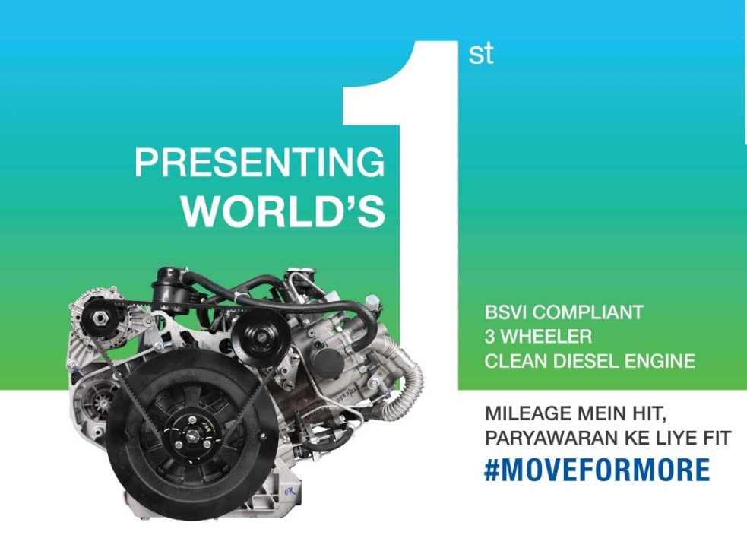
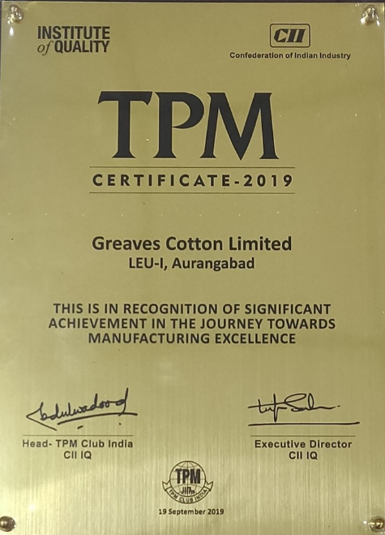


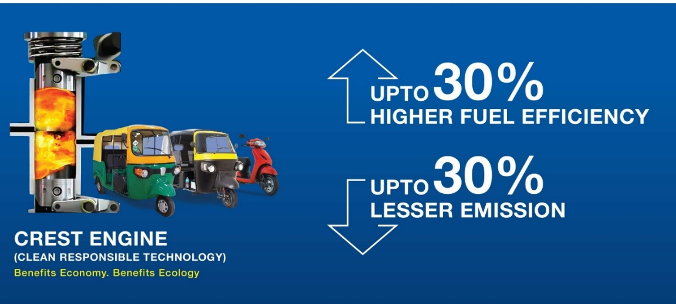



Greaves Engines

Slide 7
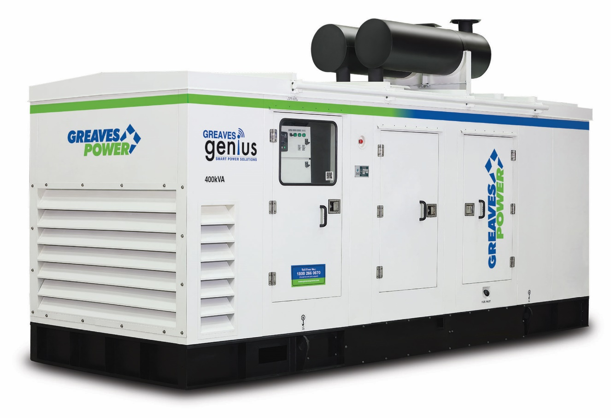
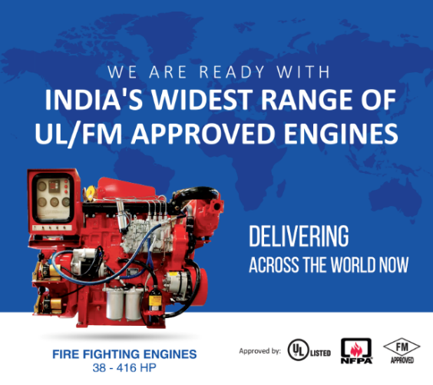

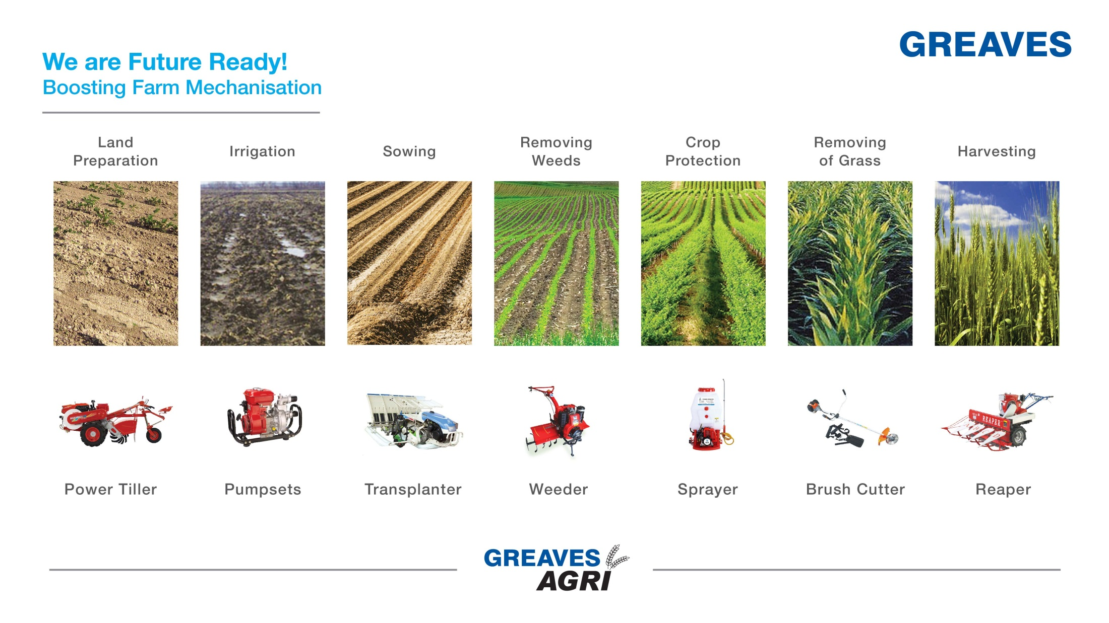
Greaves Non-Automotive
Power | Agri | Industrial Engines
India’s first Intelligent and technologically advanced Smart Gensets
Timely predictive and preventive checks
Non-stop product performance for critical applications
Comprehensive health monitoring and can perform in-depth prognostic fault diagnostics
State of the art manufacturing facility manned by experts.
Conformity to stringent safety standards UL, FM, TAC and NFPA 20 norms.
Our clientele includes customers from Building segment, Oil & Gas Industry, Power, Cement, Irrigation, Coal, etc.

Slide 8
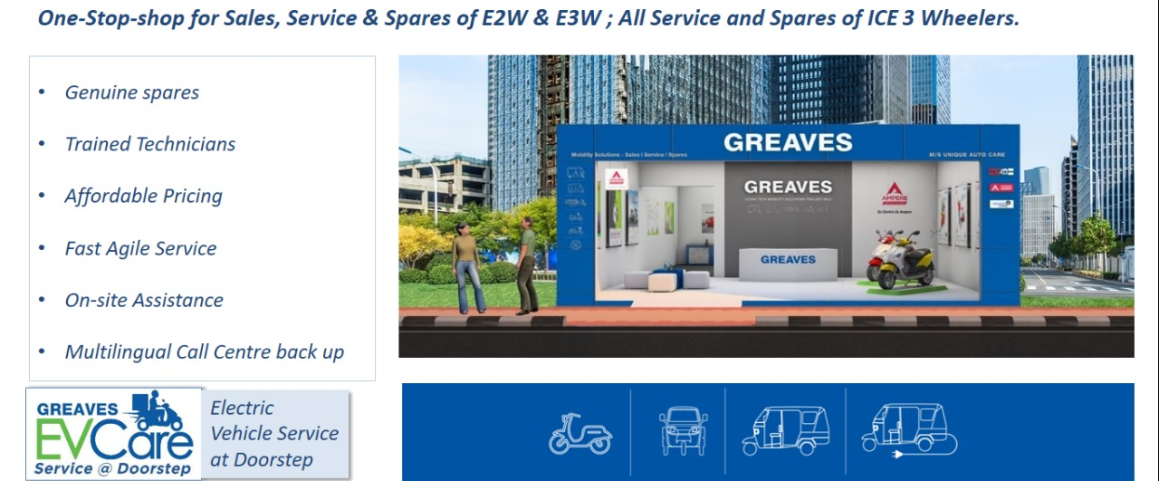
Greaves Retail

Slide 9
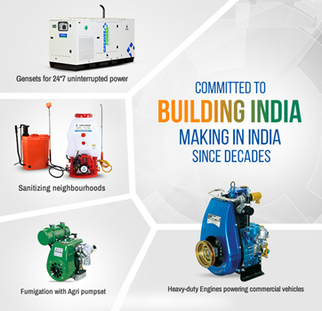
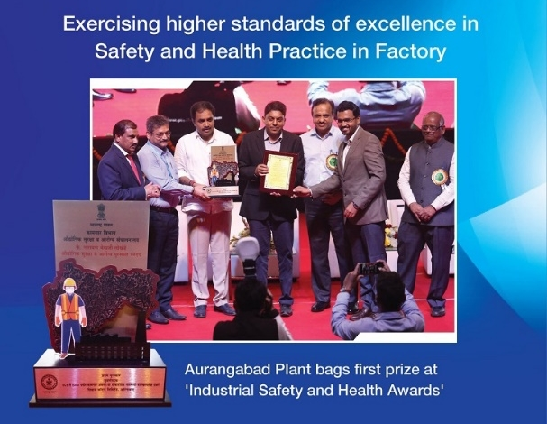

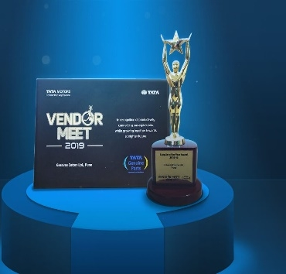

Quality certified by best Indian Associations
Certified by leading Indian Quality institute
‘Supplier of the Year’ from a recognized Indian conglomerate

Slide 10
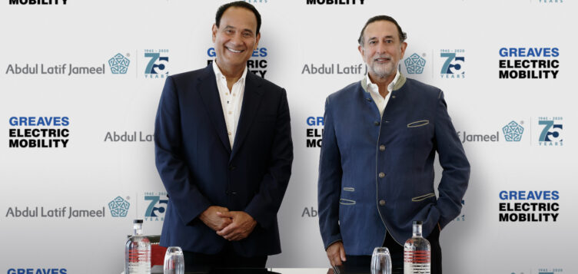
Abdul Latif Jameel has announced its commitment to invest up to $220 million [INR 1700 Crores*] in Greaves Electric Mobility – one of India’s leading two-to-three-wheeler Electric Vehicles (EV) manufacturers
Abdul Latif Jameel will initially invest $150 million [INR 1160 Crores*] for a 35.8% stake in Greaves Electric Mobility, making it the company’s second-largest shareholder
This investment will accelerate the development of India’s rapidly expanding two-to-three-wheeler EV ecosystem, furthering Abdul Latif Jameel’s objective to bring affordable EV products to the Global South
Both parties are strategically aligned in making Greaves Electric Mobility a significant Electric Mobility player
Greaves Electric Mobility offers cleaner alternatives for two-to-three-wheeler vehicles that are accessible to communities in India

Slide 11

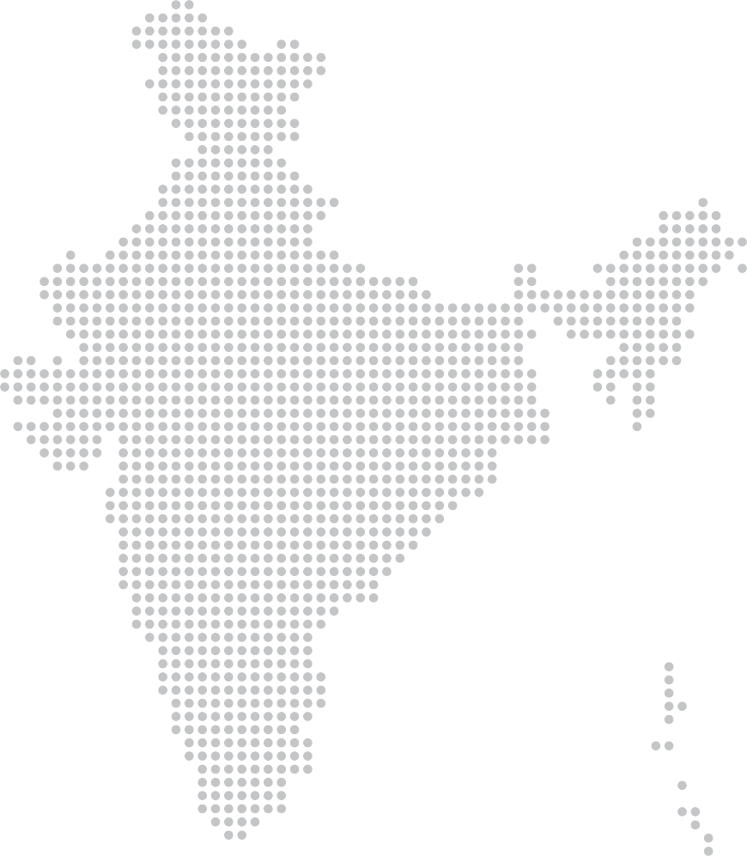



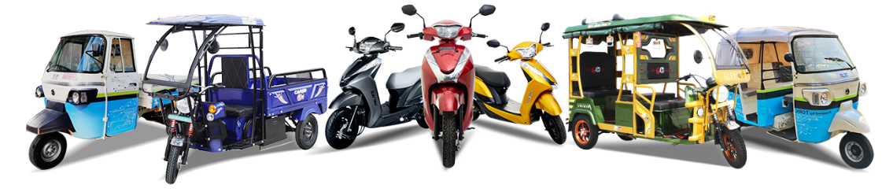
Strengthening of MLR with Greaves Electric Mobility
Nation-wide reach with more than 500+ Greaves Electric Mobility touchpoints and more than 1,00,000+ customers
E-Scooters
E-Rickshaw
E-Auto

Slide 12
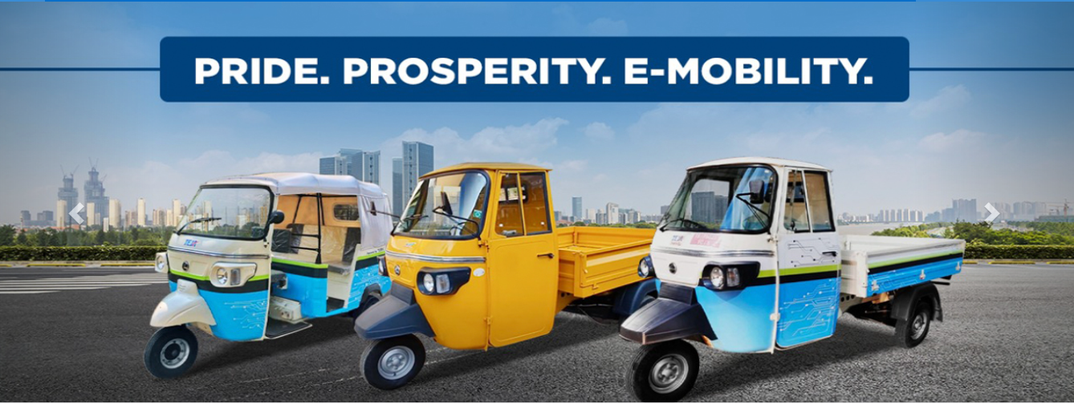

Slide 13
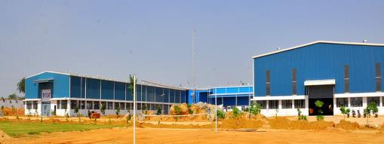
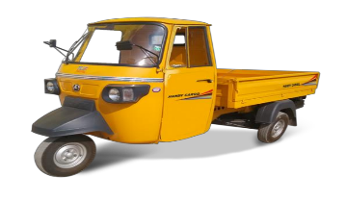

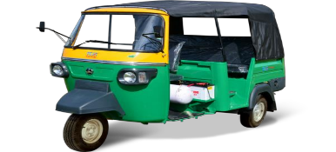

About MLR Autos
  A reputed and renowned Three Wheeler brand from the city of pearls, Hyderabad established in year 2015
  Multi-fuel product expertise with three wheelers in Petrol, Diesel and Electric manufactured at State-of-Art facility at Toopran, Hyderabad
  Offers widest range of Three-wheelers in Passenger & Cargo in Diesel, Petrol, E-Auto (L5) and E-Rickshaw
BS VI Cargo
BS VI Passenger
EV Cargo
EV Passenger

Slide 14
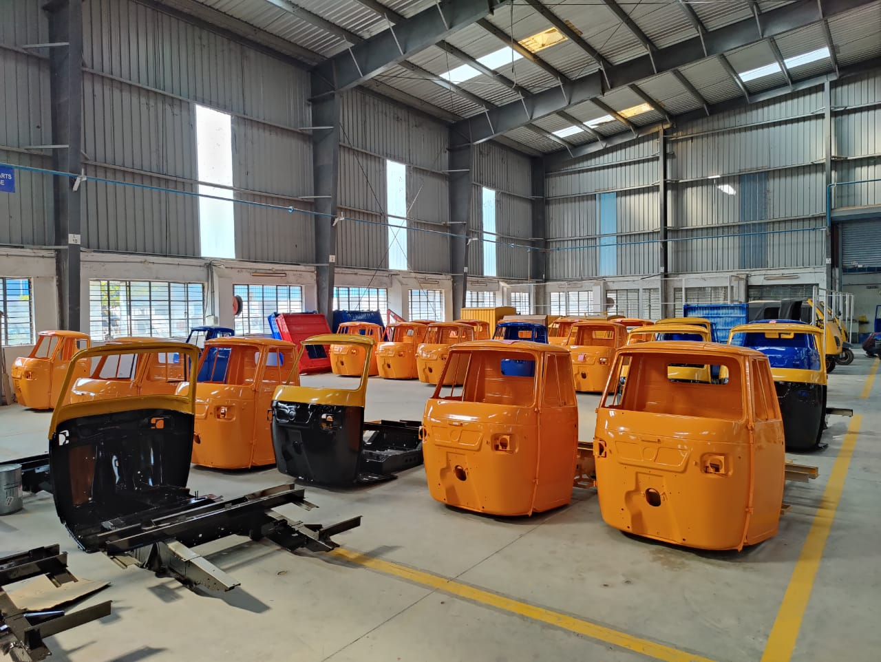
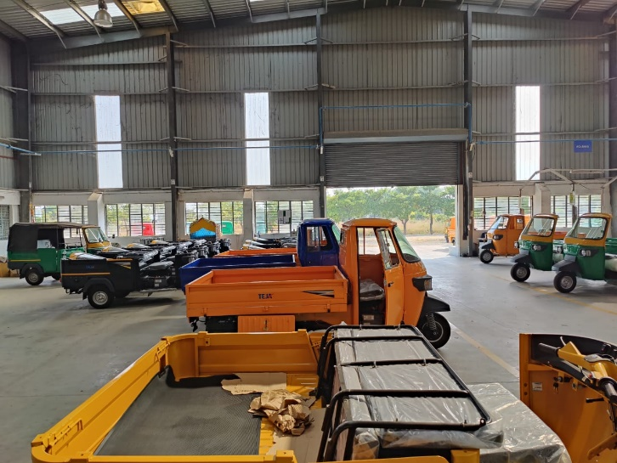
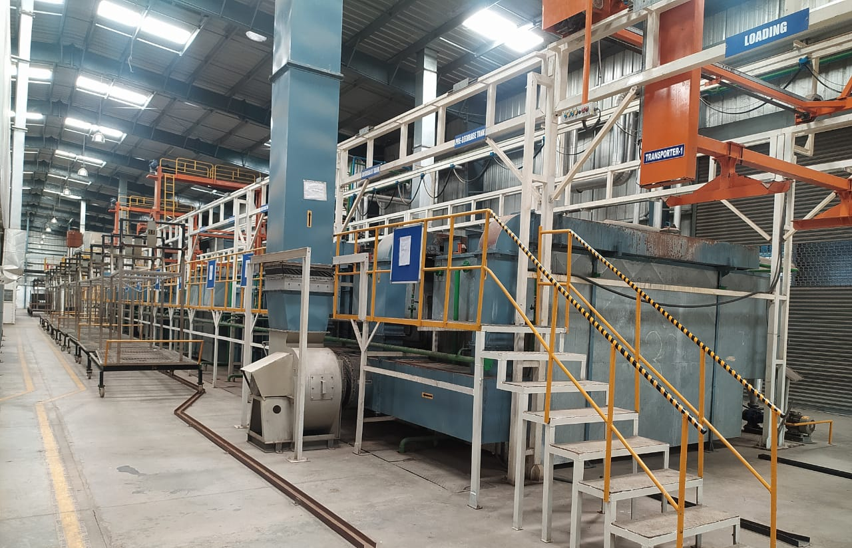
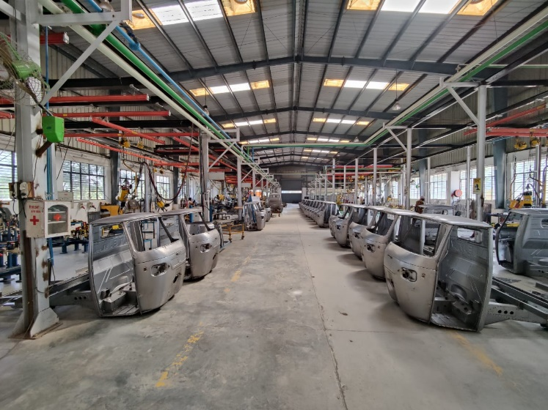
Teja Advantage
Strong & rugged Vehicle body
Unique & aesthetically designed vehicle
Good long life paint quality

Slide 15
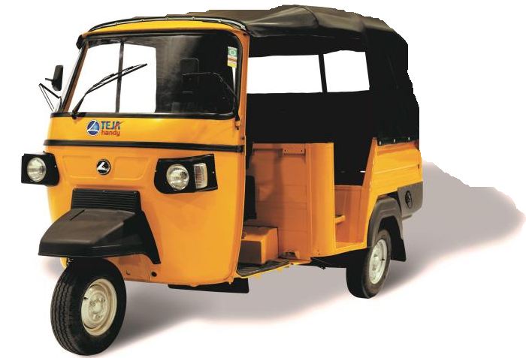
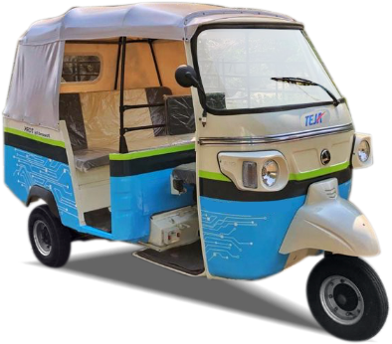
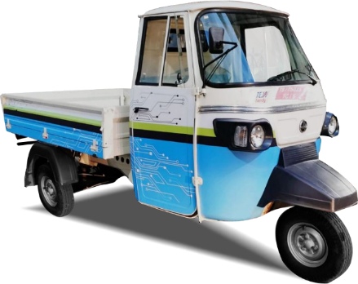
Wide Product Portfolio
PASSENGER
CARGO
TEJA HANDY
BSVI DIESEL
435 & 600cc engine with 4+1 Speed Gearbox
Strong build quality
Wide passenger entry
Spring suspended driver seat for comfort
190mm Ground clearance
600cc engine with 4+1 Speed 435 & Gearbox
Extra long deck with strengthened panel
Heavy duty front & rear suspension
500kg Payload
TEJA HANDY
CNG
400cc Water cooled with 4+1 Speed Gearbox
Best in class fuel efficiency
Low maintenance & spacious interior
Hydraulic dual action suspension with Shock absorber
400cc Water cooled with 4+1 Speed Gearbox
Best in class fuel efficiency
Low maintenance & spacious interior
Hydraulic dual action suspension with Shock absorber
TEJA EV
ELECTRIC
FAME II Certified with 48kmph high speed & 132km per charge
Unique two-speed gearbox to carry load on steep gradient
All-weather proof metal body with CED Paint technology
FAME II Certified with 48kmph high speed & 132km per charge
Unique two-speed gearbox to carry load on steep gradient
All-weather proof metal body with CED Paint technology
500kg payload | Tested for 750kg

Slide 16
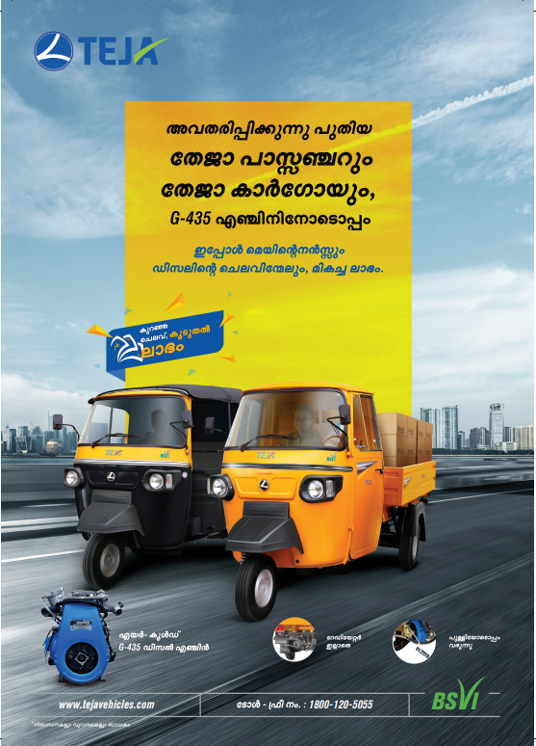
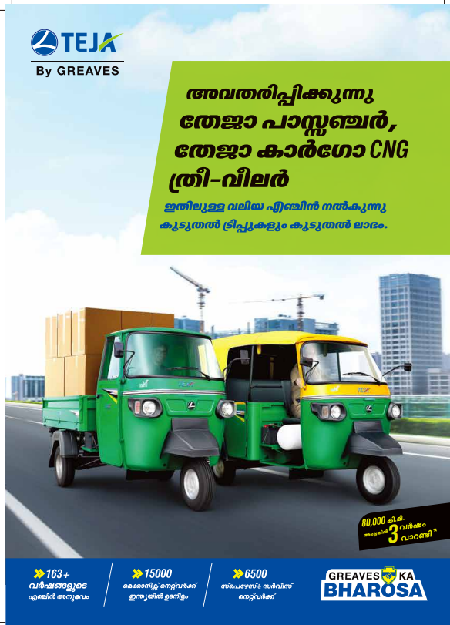
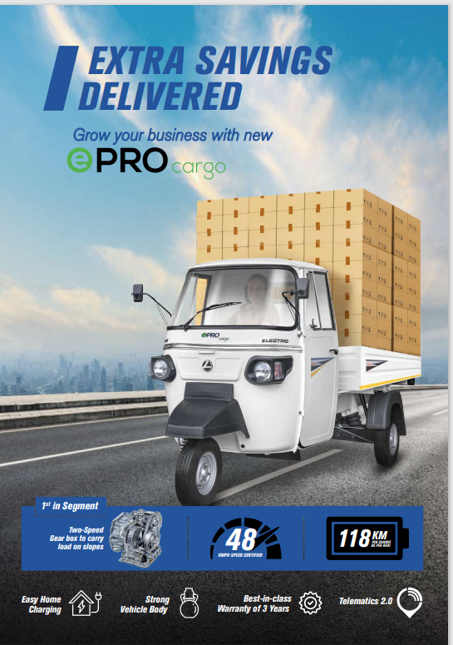
Wide Product Portfolio

Slide 17
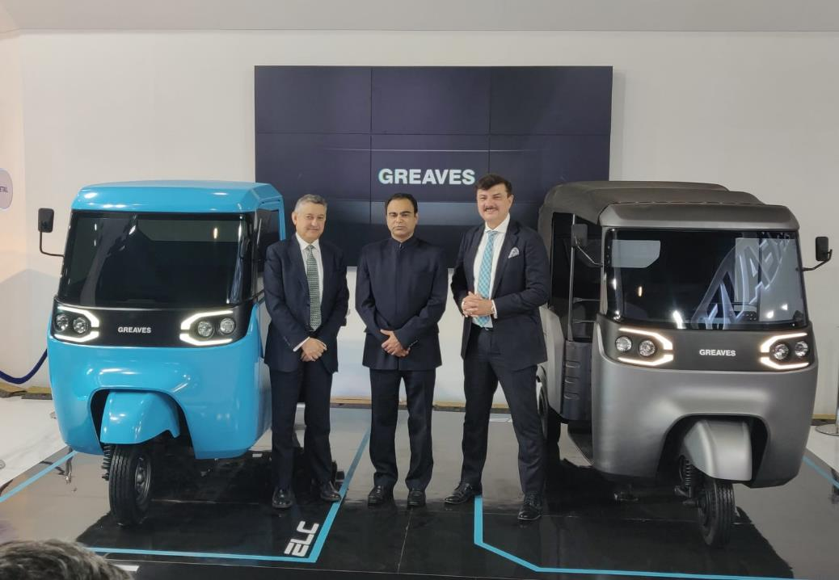
Pictures of the Greaves leadership team next to Greaves ELC & Greaves ELP

Slide 18
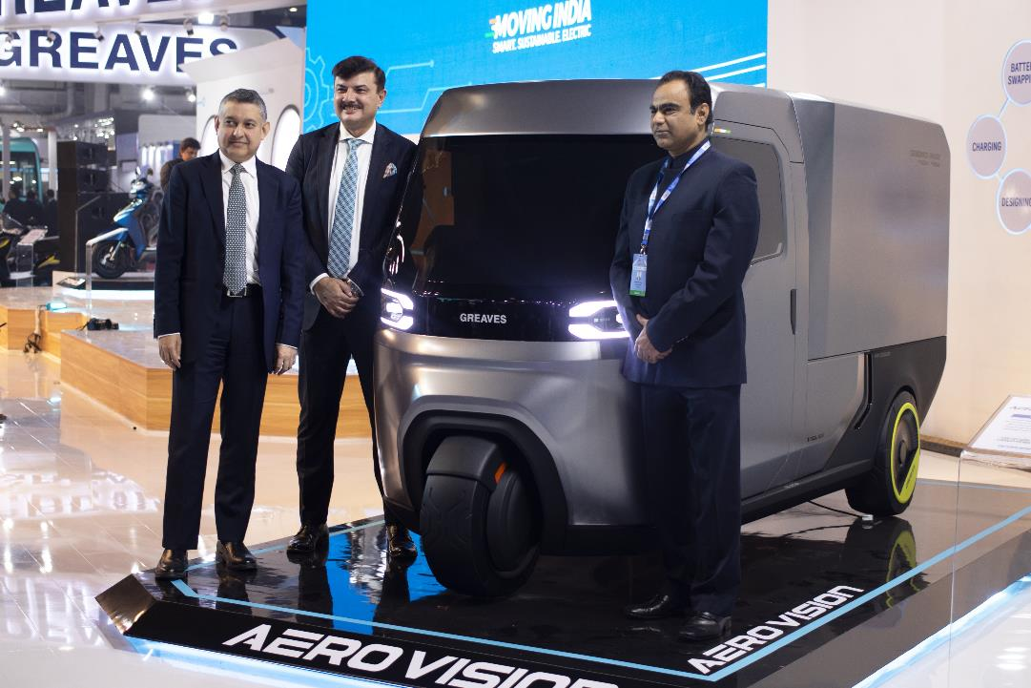
Pictures of the Greaves leadership team next to Greaves Aero Vision

Slide 19


Slide 20
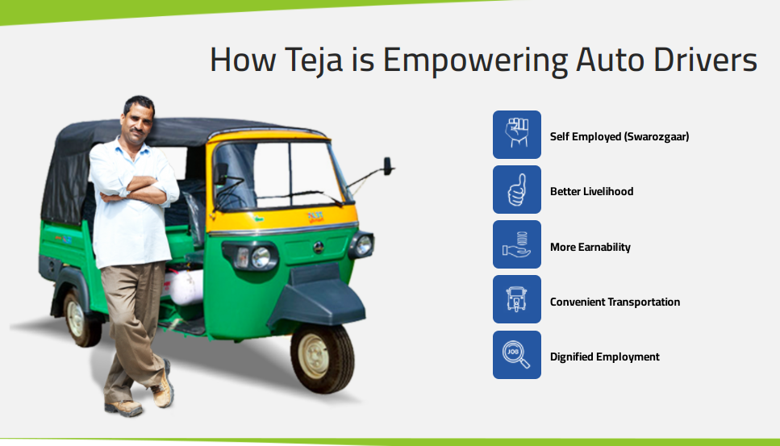

Slide 21
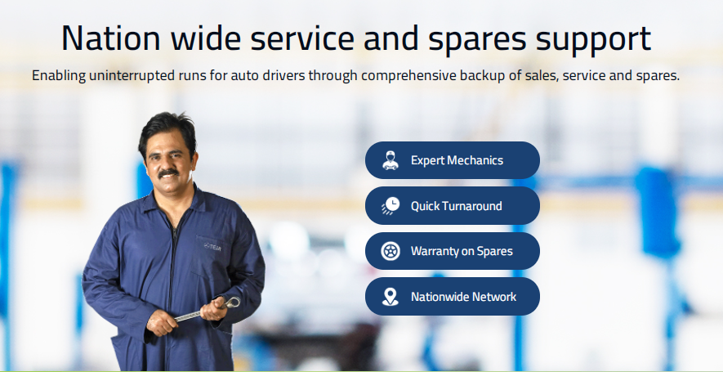

Slide 22
EXPERIENCE
THRIVOLUTION

